Slide 1
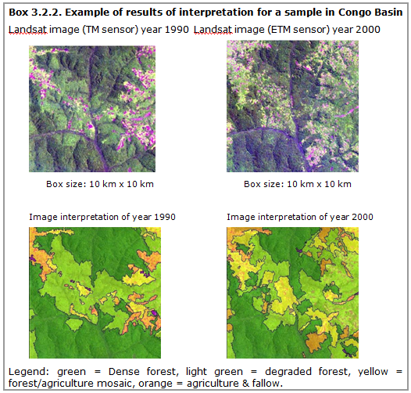



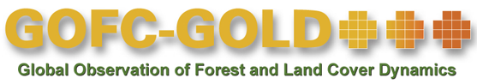
Module 2.1 Monitoring activity data for forests using remote sensing
Module developers:
  Frédéric Achard, European Commission (EC)– Joint Research Centre (JRC)
  Jukka Miettinen, EC–JRC
  Brice Mora, Wageningen University
  After the course the participants should be able to:
Differentiate between different (remote sensing) approaches to monitor changes in forest areas
Perform forest area change analysis using Landsat satellite data
Source: GOFC-GOLDSourcebook 2014, Box 3.2.2.
V1, May 2015
Creative Commons License
Notes:
Hello, my name is Frédéric Achard. I am a research scientist with the Joint Research Centre (JRC), based in Northern Italy
Today you will learn about Module 2.1 of the GOFC-GOLD REDD+ Sourcebook.
This module is dealing with Monitoring activity data for forests using remote sensing

Slide 2
Background material
GOFC-GOLD. 2015. Sourcebook. Sections 1.2, 2.1, 2.7, and 2.9. Section 3.2 for country examples.
  UNFCCC. 2011. Decision 1/CP16. The Cancun Agreements. http://unfccc.int/resource/docs/2010/cop16/eng/07a01.pdf#page=2
  IPCC. 2003. Good Practice Guidance for Land Use, Land-Use Change, and Forestry.
GFOI. 2016. Integrating Remote-sensing and Ground-based Observations for Estimation of Emissions and Removals of Greenhouse Gases in Forests: Methods and Guidance from the Global Forest Observation Initiative (MGD). Sections 2.2.1 and 3.
Notes:
The module is Linked to sections 2.1 of GOFC-GOLD Sourcebook (Monitoring of Changes in Forest Area) and section 3.2 (Overview of the Existing Forest Area Changes Monitoring Systems: Country examples of Brazil, India, and Central Africa)
GOFC-GOLD Sourcebook has been updated in 2015
Need to take into consideration the UNFCCC Paris Agreement (Dec 2015) and the REDD+ decision booklet (2014) available on UNFCCC website (REDD+ section)
The Methods and Guidance from the Global Forest Observation Initiative (GFOI) was updated in October 2016 version 2.0

Slide 3
Outline of lecture
Introduction
Selection of a monitoring approach
Image classification and analysis
Accuracy assessment
Limitations to using satellite data
Notes:
An Introduction for forest cover monitoring in the context of UNFCCC will be given shortly at the beginning.
The presentation will concentrate on sections 2 to 4 which present the state of the art for data and approaches to be used for monitoring forest area changes at the national scale in tropical countries using satellite remote sensing imagery.
Finally, major limitations of using satellite data are briefly highlighted.

Slide 4
Outline of lecture
Introduction
Selection of a monitoring approach
Image classification and analysis
Accuracy assessment
Limitations to using satellite data

Slide 5
IPCC requirements for measuring and reporting of changes in forest area (1/2)
The IPCC methodologies and UNFCCC reporting principles have been identified as the basis for the REDD+ activities
IPCC methodologies aim for full, accurate, transparent, consistent, and comparable reporting of GHG emissions and removals (e.g., of changes in forest areas)
Reporting also includes a detailed description of the used inventory approach and planned improvements
See Module 3.3 on reporting REDD+ performance.
Notes:
Activities to reduce emissions from deforestation and forest degradation or activities to enhance forest carbon stocks in developing countries have been included in the Paris Agreement
In this context the IPCC methodologies and UNFCCC reporting principles have already been identified as the basis for the future REDD+ activities.
Methodological issues need to be addressed in order to produce estimates that are comparable, i.e. “results based, demonstrable, transparent, and verifiable, and estimated consistently over time”

Slide 6
IPCC requirements for measuring and reporting of changes in forest area (2/2)
IPCC guidelines refer to two basic inputs with which to calculate greenhouse gas inventories: activity data and emissions factors.
For activity data, spatially explicit land conversion information, derived from sampling or wall-to-wall mapping techniques, is encouraged.
Notes:
The IPCC Guidelines describe three different approaches for representing the activity data, or the change in area of different land categories:
Approach 1 identifies the total area for each land category—typically from non-spatial country statistics—but does not provide information on the nature and area of conversions between land uses, i.e., it provides only “net” area changes (e.g. deforestation minus forestation) and thus is not suitable for REDD+.
Approach 2 involves tracking of land conversions between categories, resulting in a non-spatially explicit land-use conversion matrix.
Approach 3 extends Approach 2 by using spatially explicit land conversion information, derived from sampling or wall-to-wall mapping techniques.
under REDD+, land-use changes need to be identifiable and traceable in the future, that is, only Approach 3 (or Approach 2 with additional information on land use dynamic) can be used for REDD+ implementation.
For reference, note that the GFOI methods and guidance document (GFOI 2016), has an example of a decision tree (figure 2, p. 33) for the selection of a Tier and Approach to be used.

Slide 7
Key role for earth observation in monitoring tropical forests
Fundamental requirement of national monitoring systems are that they:
  Measure changes throughout all forested area
  Use consistent methodologies at repeated intervals to obtain accurate results and
  Verify results with ground-based or very high resolution observations
The only practical solution to implement such monitoring systems in tropical countries often with low accessibility to forest areas is through interpretation of remotely sensed data supported by ground-based observations.
Notes:
Remote sensing, which refers to data acquired by sensors onboard aircraft and space-based platforms, is often the only practical solution for national forest area monitoring in tropical or developing countries.
Remote sensing techniques can be used to monitor changes in forest areas—e.g., from forest to nonforest land (deforestation) and from nonforest land to forest land (forestation).
The techniques to monitor changes in forest areas (e.g., deforestation) provide high-accuracy activity data (area estimates) and can also allow reducing the uncertainty of emission factors through spatial mapping of main forest ecosystems.
Monitoring of forestation area has greater uncertainty than monitoring deforestation. This is because deforestation normally causes a sudden and clearly noticeable change in remote sensing data, while forestation is typically a slower and more gradual process.

Slide 8
Issues affecting the selection and implementation of a monitoring approach
Multiple approaches are appropriate and reliable for forest monitoring at national scales. Issues affecting the design of the monitoring system include, for example:
    National circumstances, particularly existing definitions and data sources
    Decision on change assessment approach, defined by:
        Satellite imagery
        Sampling versus wall-to-wall coverage
        Fully visual versus semi-automated interpretation
        Accuracy or consistency assessment
    Available resources:
        Hard- and software resources
        Required training
Notes:
There is no single solution for nationwide forest monitoring. Optimal solutions vary depending on national circumstances.
In this slide, typical issues affecting the selection and implementation process of the remote sensing method area are listed.
An optimal combination of methods needs to be found so that a scientifically credible national assessment can be technically accomplished by in-country experts.
A hybrid approach combining automated digital segmentation or classification techniques with visual interpretation or validation of the resulting classes should be preferred as a simple, robust, and cost-effective method.

Slide 9
Outline of lecture
Introduction
Selection of a monitoring approach
Image classification and analysis
Accuracy assessment
Limitations to using satellite data
Notes:
Sections 2 to 4 present the state of the art for data and approaches to be used for monitoring forest area changes at the national scale in tropical countries using remote sensing imagery.
Approaches and data for monitoring changes of forest areas (deforestation and forestation) will be described and general recommendations for steps to be taken are given.

Slide 10
Required activity data
Depending on national decisions on the approach to be used, the following types of maps may be useful for reporting on the changes in forest cover:
  Forest/nonforest map (+ change maps)
  National land-cover/land-use map (+ change maps)
  Forest stratification
  Map of changes within forest land (see Module 2.2)
A monitoring approach suitable for producing the required activity data needs to be selected: a sample of reference data need to be used to produce accurate estimates
Notes:
a sample of reference data need to be combined with the forest map to be used as stratification.
For detailed information on steps to combine a sample of reference with wall to wall maps see Chapter 5 GFOI v 2.0 (2016) on “Estimation and uncertainty”.

Slide 11
Forest definition (1/2)
Currently Annex I parties use the UNFCCC definition of forest and deforestation adopted for implementation of Articles 3.3 and 3.4 of Kyoto protocol.
FAO uses a minimum cover of 10%, height of 5 m and area of 0.5 ha, stating also that forest use should be the predominant land use in the area.
For the Kyoto Protocol, parties should select a single value of crown area, tree height, and area within following ranges:
  Minimum forest area: 0.05 to 1 ha
  Potential to reach a minimum height at maturity in situ of 2–5 m
  Minimum tree crown cover: 10–30 %
Notes:
Definition of FAO comes from the Forest Resource Assessment programs (FRA 2010 and FRA 2015)
Selection of value of crown area, tree height, and area for the Kyoto Protocol must be done with the understanding that young stands that have not yet reached the necessary cover or height are included as forest.
Subcategories of forests (e.g., forest types) can be defined within the framework definition of forest.

Slide 12
Forest definition (2/2)
No agreement on a forest definition currently exists under REDD+.
Countries can choose their own forest definition as long as they clearly describe the definition.
  Note that remote sensing imagery allows land cover to be observed; field information is needed to derive land use.
Notes:
Note that there is currently no agreement on a forest definition under REDD+.
Countries can choose their own forest definition as long as they clearly describe the definition.
Note also that remote sensing imagery allows land cover to be observed. Local field information is needed to derive land use.

Slide 13
Designation of forest area
Ideally, wall-to-wall assessments would be carried out to identify forested area according to UNFCCC forest definitions.
Alternatively, existing forest maps for a relatively recent time could be used to identify the overall forest extent.
Important principles in identifying the forest extent:
  The area should include all forests within the national boundaries
A consistent overall forest extent should be used for monitoring all forest changes during assessment period
Notes:
Many types of land cover exist within national boundaries.
REDD+ monitoring needs to cover all forest areas and the same area needs to be monitored for each reporting period.
For the first element of REDD+ related to decreases in forest area (deforestation), it will not be necessary or practical in many cases to monitor the entire national extent that includes nonforest land types.
Therefore, a forest mask can be designated initially to identify the area to be monitored for each reporting period, referred to in GOFC-GOLD Sourcebook as the “benchmark map.”

Slide 14
Selection of satellite imagery
Many different types of data from optical sensors at a variety of resolutions and costs are available for monitoring deforestation.
The selection of the type of satellite data depends on national circumstances (forest types, size of the country, seasonality, available funds, etc.).
The most commonly used types of satellite data for forest-cover monitoring are listed on the next slide with a summary of their usability for various purposes.
Notes:
Remote sensing data serve a key role not only in mapping current forest cover but also in establishing historical deforestation rates.
Optical mid-resolution data have been the primary tool for deforestation monitoring. The USA National Aeronautics and Space Administration (NASA) Landsat data series goes back to the 1970s. Currently Landsat 8 continue to deliver images of every location on in 16-day intervals.
Data from Lidar and Radar have been shown to be useful in project studies, but so far they are not widely used operationally for forest monitoring over large areas.
In addition to the spatial and temporal resolution and financial issues, one important aspect to take into account in selection of remote sensing data is the seasonality of climate: in situations where seasonal forest types (e.g., a distinct dry season where trees may drop their leaves) exist, more than one scene should be used.

Slide 15
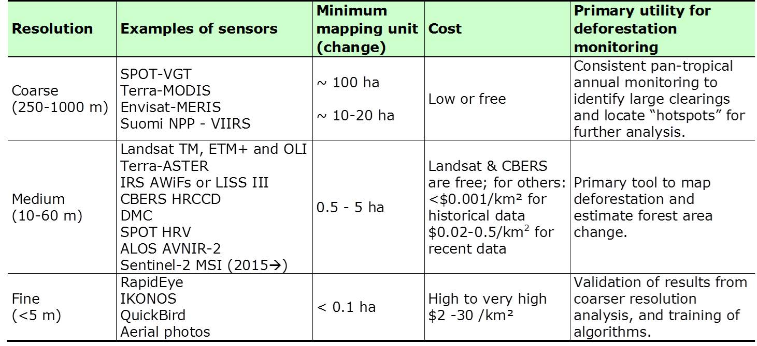
Utility of optical sensors at multiple resolutions for deforestation monitoring
Source: GOFC GOLD Sourcebook 2014, table 2.1.1.
Notes:
Almost complete global coverage from Landsat satellites for early 1990s, early 2000s, around year 2005, around year 2010 and from year 2013 are available for free download through web portals at the U.S. Geological Survey.
Landsat-type data around years 2000, 2005, 2010 and 2015 will be most suitable to assess historical rates and patterns of deforestation. Alternative sources of data include ASTER, SPOT, IRS, CBERS, DMC, AVNIR-2 or RapidEye data.
For continuity of Landsat type data, Landsat 8 OLI and Sentinel-2 MSI sensors play an important role.
Coarse resolution (250 m–1km) data cannot be used directly to estimate area of forest change. However, in cases where clearings are large and/or change is rapid, analysis of coarse resolution data can be used to identify where change in forest area has occurred. Coarse resolution data to identify deforestation hotspots is useful to design a sampling strategy
Fine resolution (< 5m) data, such as those collected from commercial sensors (e.g., IKONOS, QuickBird, RapidEye) and aircraft, can be prohibitively expensive to cover large areas. However, these data can be used to calibrate algorithms for analyzing medium- and high-resolution data and to calibrate the results—that is, they can be used for assessing the accuracy.
For further information on available satellite data see, for example, the methods and guidance document GFOI.

Slide 16
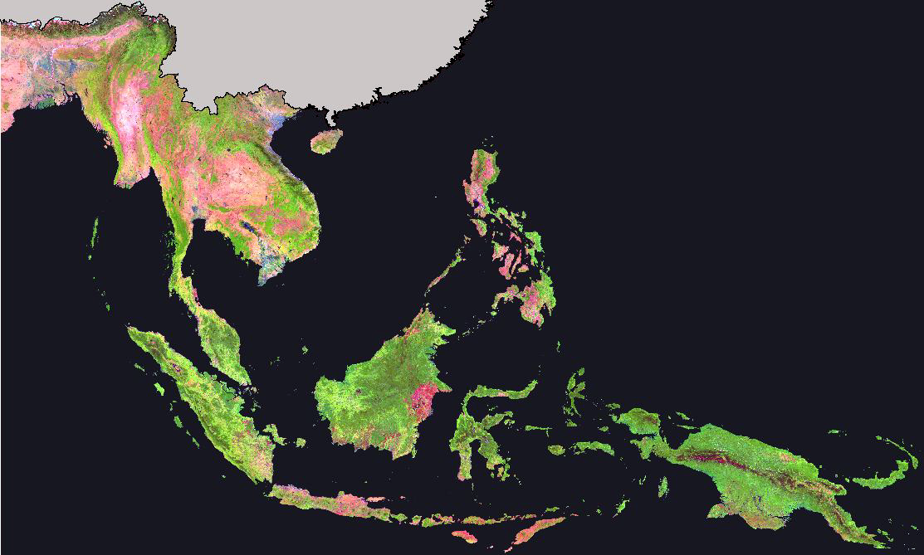
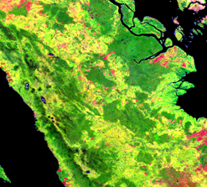
Example of a 1 km resolution SPOT VGT image composite for year 2000 covering Southeast Asia
Source: JRC, Stibig et al, 2003
Notes:
The image presents an overall view and a subset of a composite image built using 1 km spatial resolution SPOT Vegetation (VGT) images acquired between 1998 and 2000.
This mosaic was then clustered using unsupervised clustering into 60 clusters, which were assigned into nine classes using available information from the field, from satellite images and from existing maps and elevation datasets.

Slide 17
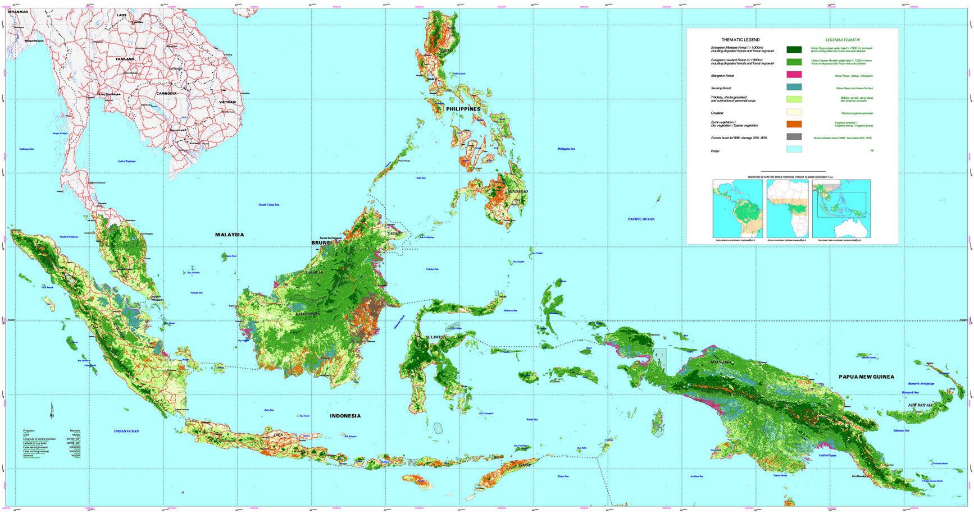
Example of forest cover map for insular Southeast Asia derived from 1 km SPOT VGT imagery
Evergreen montane forest
Evergreen lowland forest
Mangrove forest
Swamp forest
Thickets, shrubs, grassland, and cultivation of perennial crops
Cropland
Burnt / dry / sparse vegetation
Forests burnt in 1988, damage 25%–80%
Water
Source: JRC, Stibig et al, 2003
Notes:
This slide presents the final map created from the coarse resolution SPOT VGT composite shown in the previous slide.

Slide 18
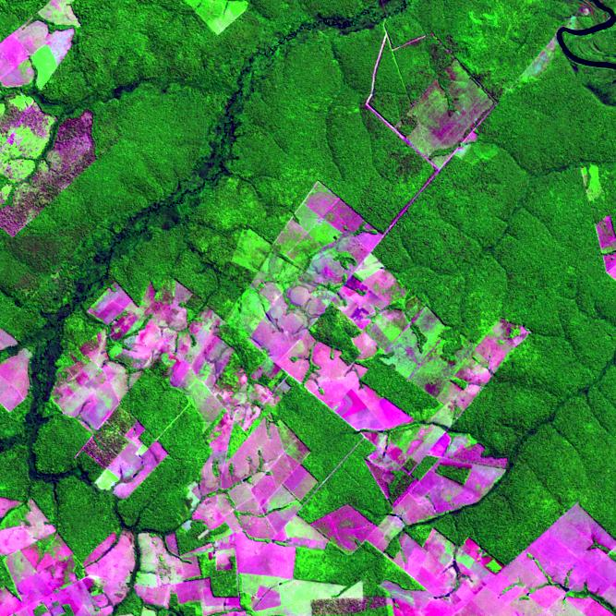
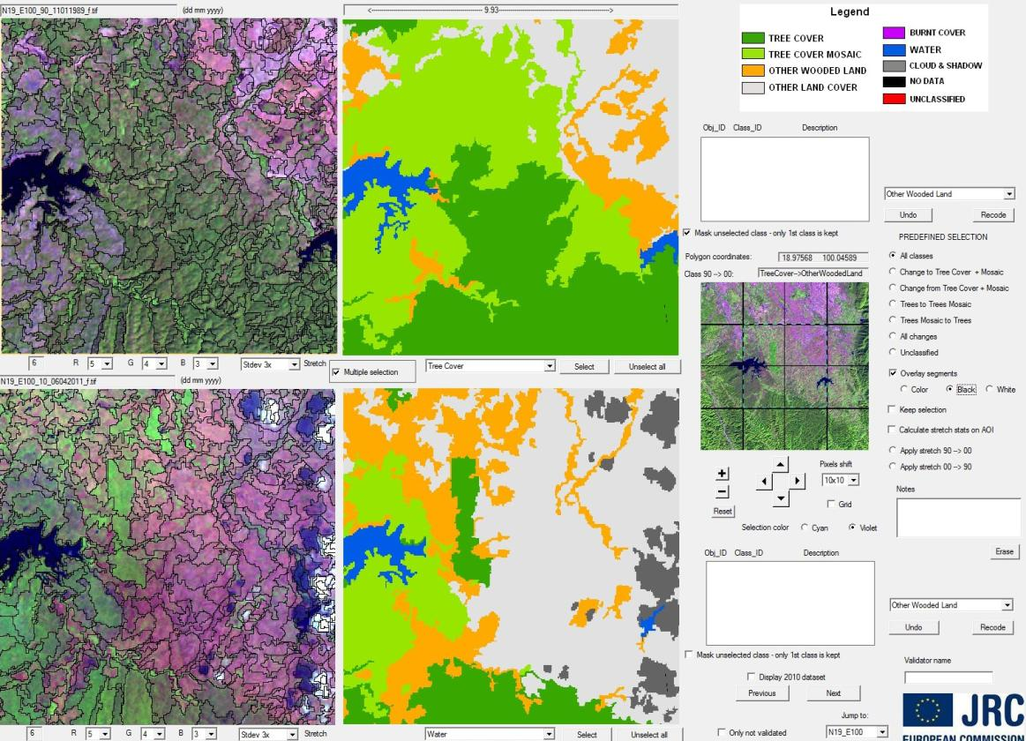
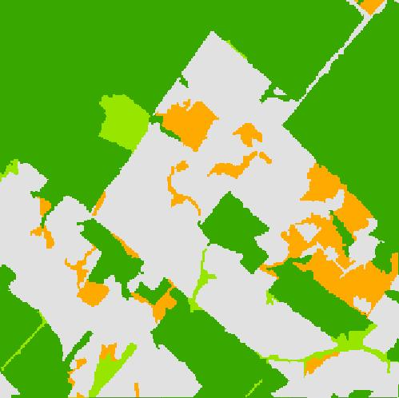
Example of forest cover map derived from 30 meter Landsat TM imagery over a site in Brazil
Legend
Tree cover
Tree cover mosaic
Other wooded land
Other land cover
Forest cover map
10 km x 10km window size
Centered at 12°S, 58°W
Landsat-5 TM image of 15 June 2005: 20 km x 20 km extract
Sources: USGS 2015;
Eva, et al. 2012.
Notes:
This image shows an example of forest cover mapping using 30 m resolution Landsat image.
The mapping is based on semi-automated approach starting with image segmentation and followed by initial classification utilizing land cover signature database, with subsequent visual validation.
The methodology is described in more detail in the accompanying exercise documents.)

Slide 19
Decision for wall-to-wall versus sample coverage
Wall-to-wall is a common approach if appropriate for national circumstances.
If resources are not sufficient to complete wall-to-wall coverage, sampling is more efficient for large countries and is needed to produce more accurate estimates of activity data
Recommended sampling approaches are systematic sampling and stratified sampling. See next slide.
Notes:
Brazil and India have already demonstrated that operational wall-to-wall systems can be established based on mid-resolution satellite imagery (Landsat TM or IRS)
Brazil has measured deforestation rates in Brazilian Amazonia since the end of the 1980s. These methods can be easily adapted to cope with smaller country sizes.
Global wall-to-wall maps of tree cover and tree cover losses/gains over the period 2000–2012 were published at the end of 2013, with reported accuracies greater than 80% for tropical and subtropical domains. See Hansen et al. 2013.
Stratified sampling approaches for forest-area change estimation have been implemented over the tropical belt or at National level (e.g. Gabon, Guyana) .

Slide 20
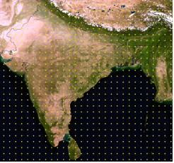
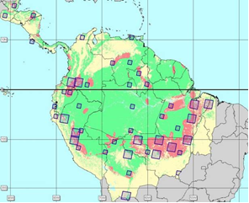
Systematic and stratified sampling
Systematic sampling obtains samples on a regular interval, e.g., one every 10 km.
Stratified samples are distributed based on proxy variables derived from coarse resolution satellite data or by combining other geo-referenced or map information.
Systematic sampling design Stratified sampling design
Source: GOFC-GOLD Sourcebook 2013, box 2.1.2.
Notes:
The images highlight two different types of sampling approaches: systematic sampling and stratified sampling.
Systematic sampling obtains samples on a regular interval, e.g., one every 10 km.
Sampling efficiency can be improved through spatial stratification (stratified sampling) using known proxy variables (e.g. Global Tree Cover Loss map).
Proxy variables can be derived from coarser resolution satellite data or by combining other geo-referenced or map information such as distance to roads or settlements, previous deforestation, or factors such as fires.

Slide 21
Outline of lecture
Introduction
Selection of a monitoring approach
Image classification and analysis
Accuracy assessment
Limitations to using satellite data

Slide 22
Processing of the satellite data
Geometric corrections:
  Location error should be < 1 pixel; baseline datasets (e.g.; GLS) can be used as alterative to GCPs or image-to-image registration
Cloud and cloud shadow masking:
  Automated or visual methods to ensure meaningfulness of image interpretation
Radiometric corrections:
  Depend on the used image interpretation method, not needed for visual single scene interpretation but crucial for automated multitemporal analysis
Notes:
Satellite imagery usually goes through three main preprocessing steps: (1) geometric corrections are needed to ensure that images in a time series overlay properly (2) cloud removal is the second step in image preprocessing, and (3) radiometric corrections are recommended to make change interpretation easier (by ensuring that images have the same spectral values for same objects).
GLS stands for Global Land Survey. GCPs stands for Ground Control Points.

Slide 23
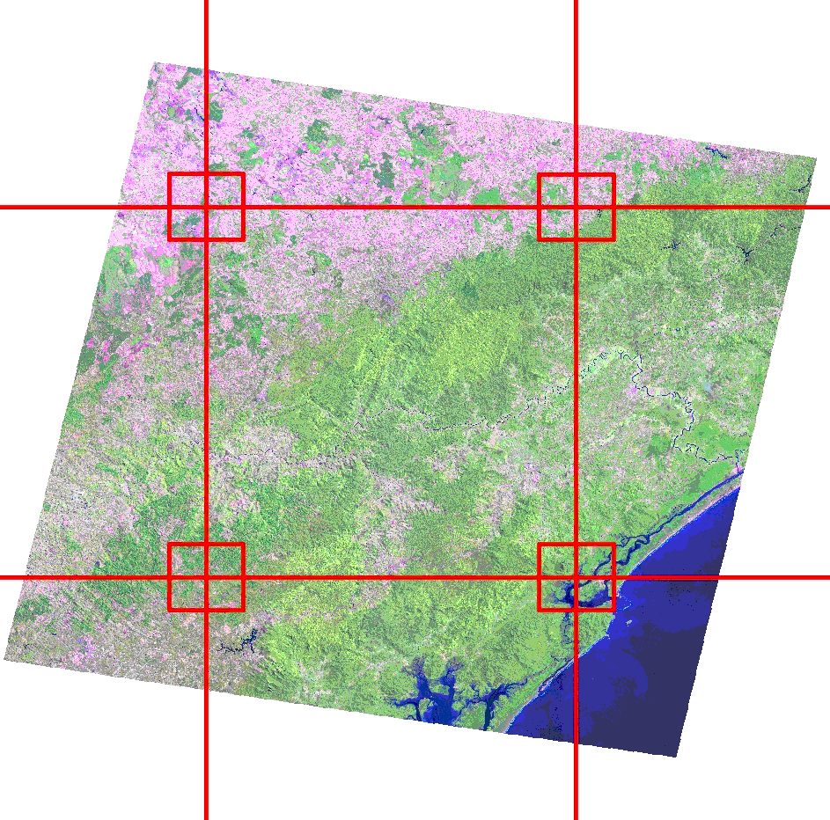
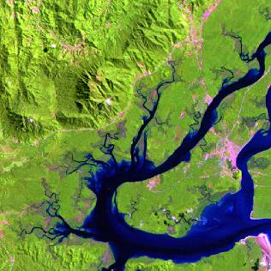
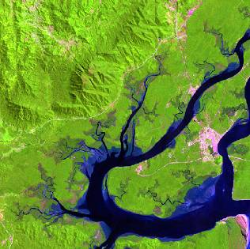
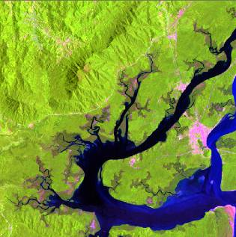
Geometric correction: example of the use of GLS dataset for image-to-image co-registration
09.09.1990
26.09.1999
04.02.2010
Landsat Scene
Centered at 25°S, 48°W: Cananéia, Brazil
Source: USGS 2015, GLS dataset.
Notes:
Presently the only free global mid-resolution (30 m) remote sensing imagery are from NASA (Landsat satellites) for around years 1990, 2000, 2005 ,and 2010 with some quality issues in some parts of the tropics (clouds, seasonality, etc.). All Landsat data from USGS archive are available for free since the end of 2008. These datasets can be used as baseline datasets for image geo-registration.

Slide 24
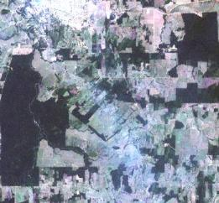
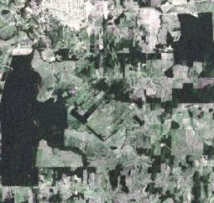
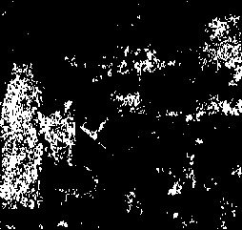
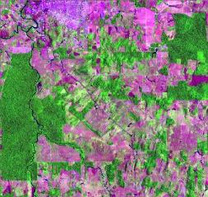
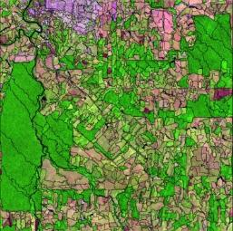
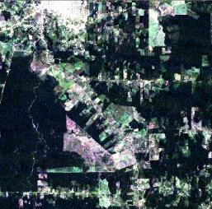
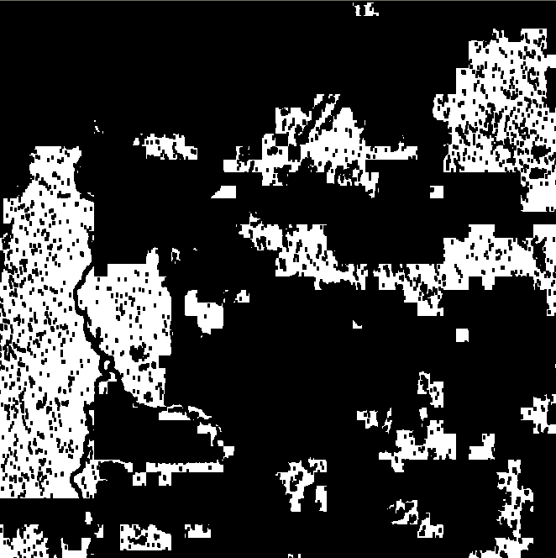
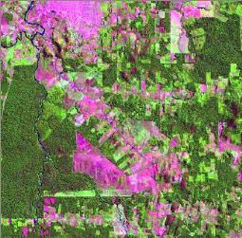
Radiometric and atmospheric correction: Example of the EC Joint Research Centre automated preprocessing chain
Calibrated ETM
De-hazed
Forest mask
Normalized
Year 2000 data >>>>>>>>>>>>>>>>>>>>>>>>
Automated preprocessing
chain
Year 2010 data >>>>>>>>>>>>>>>>>>>>>>>>
Segmentation and classification
Source: Bodart et al. 2011.
Notes:
For radiometric corrections, the requirements vary depending on the classification method. Sophisticated digital and automated approaches require radiometric correction to calibrate spectral values to the same reference objects in multitemporal datasets. This is usually done by identifying a water body or dark object and calibrating the other images to the first.
The image contamination by haze is relatively frequent in tropical regions. Therefore, when no alternative imagery is available, the correction of haze is recommended before image analysis. Topographic normalization is recommended for mountainous environments from a digital terrain model (DTM).
This slide presents a chain of preprocessing for Landsat images for sample based forest cover change mapping. Note that this approach does not require general atmospheric correction, but merely normalization of the images acquired in two different time steps over the same area. The chain starts from a top-of-atmosphere calibrated image, then (if necessary) a Tasseled Cap–based haze reduction is performed. This is followed by a basic forest mask creation, which is subsequently used for normalizing the spectral values of images acquired in different times.
After this the images are ready for multitemporal segmentation and subsequent classification

Slide 25
Analyzing the satellite data
The selection of the image interpretation method depends on available resources.
Whichever method is selected, the results should be repeatable by different analysts.
Even in a fully automated process, visual inspection of the result by an analyst familiar with the region should be carried out to ensure appropriate interpretation.
The main types of available methods for ~30 m resolution datasets are listed on the next slide, and a few important aspects of selected approaches are highlighted in the following slides.
Notes:
Many methods exist to interpret images. The selection of the method depends on available resources and whether image processing software is available. Whichever method is selected, the results should be repeatable by different analysts.
It is generally more difficult to identify forestation than deforestation. Forestation occurs gradually over a number of years while deforestation occurs more rapidly. Deforestation is therefore more visible.
Finer spatial resolution, additional field work, and accuracy assessment may be required if forestation as well as deforestation need to be monitored.

Slide 26
Main analysis methods for moderate resolution (~ 30 m) imagery
Source: GOFC-GOLD Sourcebook 2013, table 2.1.3.
Notes:
This slide categorizes the main methodological approaches for analyzing moderate resolution satellite data, ranging from point-based visual interpretation to segment-based automatic interpretation methods. Principal areas of use, as well as main advantages and limitations, are also briefly described. The choice of the most suitable method for a given situation is based several issues as described in other sections of this lecture.
Visual scene-to-scene interpretation of forest-area change can be simple and robust, although it is a time-consuming method. A combination of automated methods (segmentation or classification) and visual interpretation can reduce the work load.
Automated methods are generally preferable where possible because the interpretation is repeatable and efficient. Even in a fully automated process, visual inspection of the result by an analyst familiar with the region should be carried out to ensure appropriate interpretation of the reference sample data.

Slide 27
Visual delineation of land entities
Visual delineation of land entities is a viable approach for forest-area monitoring, particularly if image analysis tools and experiences are limited.
The visual delineation of land entities on printouts (used in former times) is not recommended; on screen delineation should be preferred as producing directly digital results.
When land entities are delineated visually, they should also be labeled visually.
Notes:
The strength of purely visual delineation and interpretation is that it allows utilization of the local knowledge even in the case with no or limited technical image analysis capabilities.
To improve repeatability and to make the process faster, visual interpretation can be combined with automated processing steps. See the next slide.

Slide 28
Multidate image segmentation
Automated segmentation reduces processing time and increases detail.
It is objective and repeatable.
It delineates changed areas as separate segments.
Ideally, analysis process would include:
  Multidate image segmentation on image pairs
  Training area/class signature selection
  Supervised clustering of individual images
  Visual verification and potential editing
Notes:
Image segmentation is a process of partitioning an image into groups of pixels that are spectrally similar and spatially adjacent. Boundaries of pixel groups delineate ground objects in much the same way a human analyst would do based on its shape, tone, and texture. However, delineation is more accurate and objective since it is carried out at the pixel level based on quantitative values.
Segmentation for delineating image objects reduces the processing time of image analysis. The delineation provided by this approach is not only more rapid and automatic but also finer than what could be achieved using a manual approach. It is repeatable and therefore more objective than a visual delineation by an analyst.
Using multidate segmentations rather than a pair of individual segmentations is justified by the final objective, which is to determine change.

Slide 29
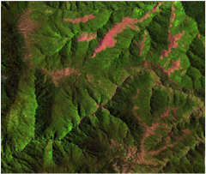
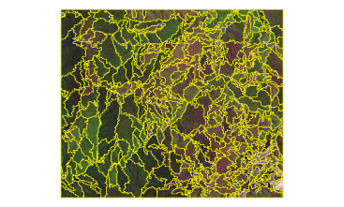
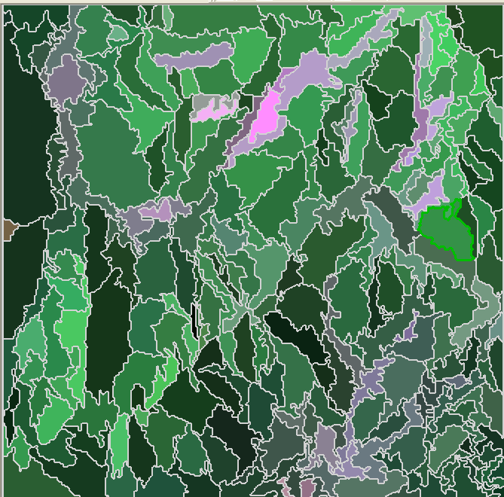
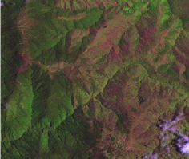
Example of semi-automatic multi-date segmentation and change labeling
1990
Paired segmentation
Automatic change label
2000
Sources: USGS 2015, GLS dataset; Bodart et al. 2011; and Raši et al. 2011.
Notes:
This slide presents an illustration of an implementation of multitemporal segmentation.
Note that in this approach, areas where land cover has changed over the observation period will form separate segments.

Slide 30
Digital classification of image segments
Digital/automatic classification applies only in the case of automatically delineated segments.
Two supervised object classifications run separately on the two multidate images are recommended instead of a single supervised object classification on the image pair.
A common predefined standard training data set of spectral signatures for each type of ecosystem should ideally be used to create initial automated forest maps.
Supervised classification approaches are considered more efficient in the case of a large number of images than unsupervised clustering techniques.
Notes:
Two supervised object classifications are easier to produce separately on two multidate images instead of applying a single supervised object classification on the image pair.
A standard training data set for supervised classification including sample sites of all the desired classes can be created using an exhaustive sample of training sites from the remote sensing data that is used in the analysis.
Although unsupervised clustering (followed by visual labeling) is also possible, for large areas it is recommended that supervised object classification be applied (with a training phase beforehand and a labeling correction/validation phase afterward). The multidate segmentation followed by supervised classification of individual dates is considered more efficient in the case of a large number of images.

Slide 31
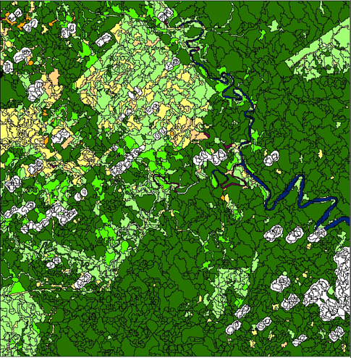
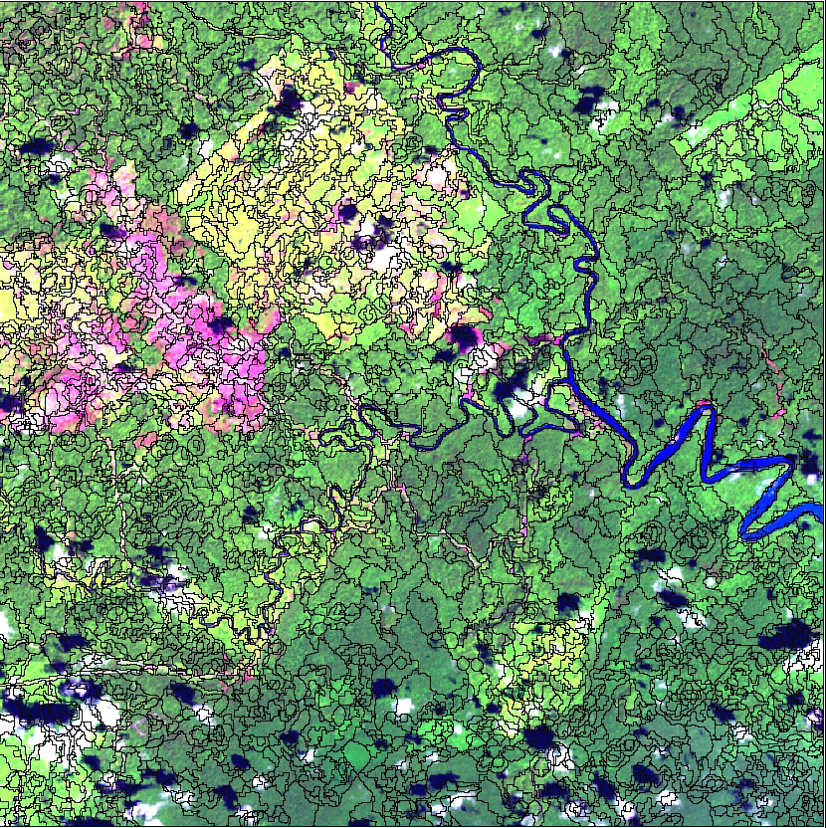

Example of automatic classification using signature database
a)
b)
a) Multitemporal segmentation (2000–2010)
b) Automated classification of the year 2000 Landsat image based on signature database
Legend
Tree cover
Shrub and regrowth
Grass, herbaceous
Sources: USGS 2015, GLS dataset; Bodart et al. 2011; and Raši et al. 2011.
Notes:
This slide presents an example of automated classification of segmented image using land cover signature database.
Note that this is only the first phase of the classification. The initial classification results (on the right) will subsequently pass through second level of labeling correction/validation phase.

Slide 32
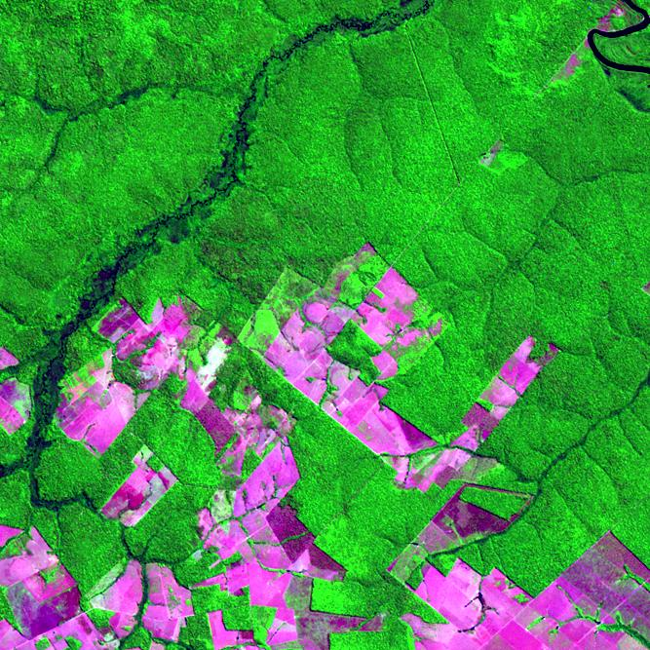
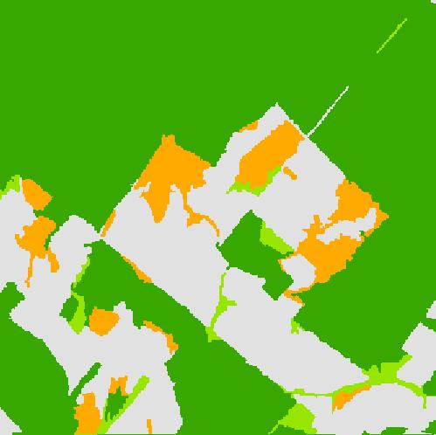
Example of forest cover change derived from Landsat TM imagery over a site in Brazil
6 August 2001
Land cover maps of 2001 to 2005
6 August 2001
Legend
Tree cover
Tree cover mosaic
Other wooded land
Other land cover
15 June 2005
15 June 2005
Landsat-5 TM imagery
Sources: USGS 2015, GLS dataset; Eva et al. 2012.
Notes:
This slide presents the basic idea of deriving forest cover change utilizing the classification approach presented in the previous slides.
Utilizing the multitemporal segments, each epoch image (in this case 2001 and 2005) is separately classified. The final classifications are then overlaid and a change matrix is created.
It is important to highlight that due to the multitemporal segmentation, the segment borders match perfectly in the two images and the changed areas are outlined as separate segments.

Slide 33
Visual verification
Visual verification (or classification) is indispensable.
Verification should take advantage of image pairs.
Existing maps may be used as support.
Single image pairs are preferred over image mosaics.
Spectral, spatial, and temporal (seasonality) characteristics of the forests have to be considered.
Notes:
Given the heterogeneity of forest spectral signatures and occasionally poor radiometric conditions, the image analysis by a skilled interpreter is indispensable to map land use and land-use change with high accuracy.
Interpretation should focus on change in land use with interdependent visual assessment of two multitemporal images together.
Scene-by-scene (i.e. site-by-site) interpretation is more accurate than interpretation of image mosaics.
Spectral, spatial, and temporal (seasonality) characteristics of the forests have to be considered during the interpretation. In the case of seasonal forests, as a minimum requirement, scenes from the same period / season of year should be used.

Slide 34
Example of visual validation of the automated JRC-FAO assessment results
Expert validation
with tailored validation Tool
Visual Control
and
Interpretation
of automated mapping
Source: USGS 2015, GLS dataset; JRC; Simonetti et al. 2011
Notes:
This slide shows a screenshot of a specially developed visual validation interface which has been used by JRC and FAO for the forest cover change analysis related to the global Forest Resource Assessment (FRA) Remote Sensing Survey (RSS) carried out for FRA-2010

Slide 35
Outline of lecture
Introduction
Selection of a monitoring approach
Image classification and analysis
Accuracy assessment
Limitations to using satellite data

Slide 36
Basic concepts of an accuracy assessment
Reporting accuracy and verification of results are essential components of a monitoring system.
Accuracy assessment should be based on higher quality data, e.g., in-situ observations or analysis of very high resolution aircraft or satellite data.
Attention needs to be given to the timing of the reference dataset, so that it matches temporally to the dataset that has been used for the forest cover mapping.
Ideally, a statistically valid sampling procedure should be used to determine accuracy; this should lead to quantitative description of the uncertainty of the forest area estimates.
Notes:
Uncertainty is an unavoidable attribute of practically any type of data, including forest area and forest area change estimates.
The proper manner of dealing with uncertainty is fundamental in the IPCC and UNFCCC contexts. The IPCC defines inventories consistent with good practice as those which contain neither over- nor underestimates so far as can be judged, and in which uncertainties are reduced as far as practicable.
Accuracy assessment of the activity data estimates is an essential part of the process of reducing the uncertainties involved in the entire REDD+ process.
Some main aspects of accuracy assessment are highlighted in the these slides. More details can be found in GOFC-GOLD Sourcebook or GFOI Methods and Guidance document

Slide 37
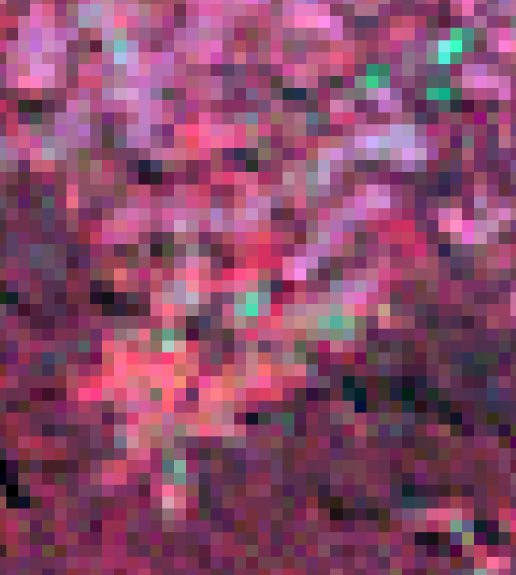
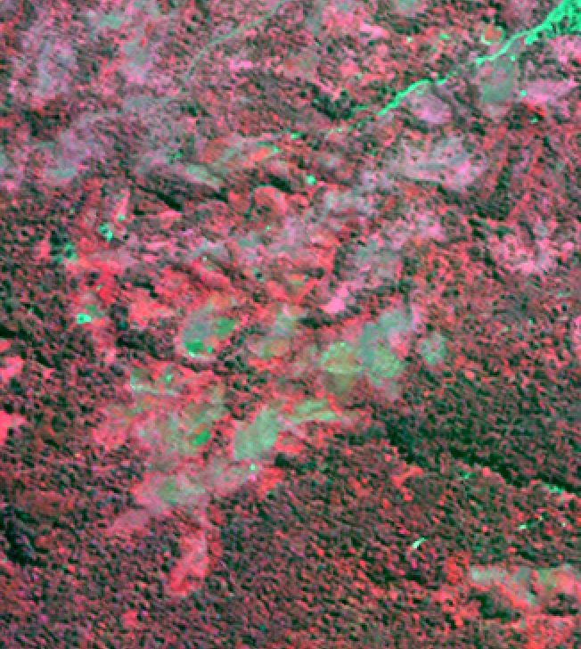
Example of the usability of very high resolution imagery for accuracy assessment
LANDSAT 30 m versus Kompsat-2 4 m resolution (RGB: NIR-R-G)
Landsat ETM+
Kompsat-2
Source: USGS 2015, GLS dataset; ESA/JRC TropForest project (Kompsat).
Notes:
This slide presents an example of the visual appearance of a 30 m resolution Landsat image (left) and a 4 m resolution Kompsat image (right) in order to highlight the great difference in the level of detail. The very high resolution datasets (like Kompsat) can be used to perform accuracy assessment for interpretations conducted using Landsat-type datasets.
The very high resolution datasets available in, e.g., the Bing Maps, or GoogleEarth may also be useful references for interpretations conducted from coarser resolution datasets (e.g., Landsat TM).
However, attention needs to be given to the timing of the acquisition of the datasets, so that the very high resolution data used for accuracy assessment matches temporally to the Landsat (or similar) dataset which has been used for the forest cover mapping.

Slide 38
Considerations for reporting
Since areas of land-cover change are significant drivers of emissions, providing the best possible estimates of these areas are critical.
It is possible to use the results of a rigorous accuracy assessment to adjust area estimates and to estimate the uncertainties for the areas for each class.
If a statistical approach is not achievable, information obtained through other means can be used to understand the accuracy of the map. Such information may include:
  Comparisons to other maps
  Systematic review and judgment by local experts
  Comparisons to nonspatial statistics
Notes:
Monitoring should work backward from a most recent reference point to use the highest quality data first and then allow for progressive improvement in methods.
More reference data are usually available for more recent time periods.
If no thorough accuracy assessment is possible or practical, it is recommended to apply the best suitable mapping method in a transparent manner. At a minimum, a consistency assessment (reinterpretation of a sub-sample in an independent manner by regional experts) should allow some estimation of the quality of the observed land change.

Slide 39
Outline of lecture
Introduction
Selection of a monitoring approach
Image classification and analysis
Accuracy assessment
Limitations to using satellite data
Notes:
In next few slides the major limitations of using satellite data are briefly highlighted.

Slide 40
Major sources of limitations
Clouds and cloud shadows
Other atmospheric effects (e.g., haze and smoke)
Effect of topography on reflectance
Insufficient observation frequency (e.g., humid tropics)
Scarcity of historical data
Tradeoff between spatial resolution and coverage
Problems of intersensor comparability (e.g., in historical time series)
Notes:
Although earth observation satellite imagery is extremely valuable for forest area monitoring, some crucial limitations need to be always taken into consideration.
The major limitation in large scale multidate projects is typically the availability of high quality observations. Issues like cloud cover and haze, combined with the temporal frequency, greatly limit the actual availability of usable satellite observations.
Second, regardless of rigorous preprocessing routines, atmospheric conditions and topography cause variation in reflectance values on which classification / interpretation is largely based on.
Furthermore, there is always a tradeoff between the spatial resolution and coverage (also related to costs). Compromises need to be made.
Finally, there are issues related to comparability of remote sensing data (and the results derived from them). This is particularly important in relation to the historic context.

Slide 41
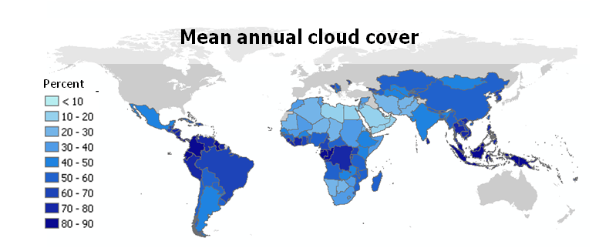
Major sources of limitations: Cloud cover
Mean annual cloud cover based on MODIS M3 Product (Cloud Fraction Mean) and EECRA (Extended Edited Cloud Report Archive)
Source: Herold 2009.
Notes:
This slide presents the mean annual cloud cover as an example to highlight the level of cloudiness in the tropical and subtropical countries.
Note that in many of the humid tropical countries the mean annual cloud cover is between 80 and 90%.

Slide 42
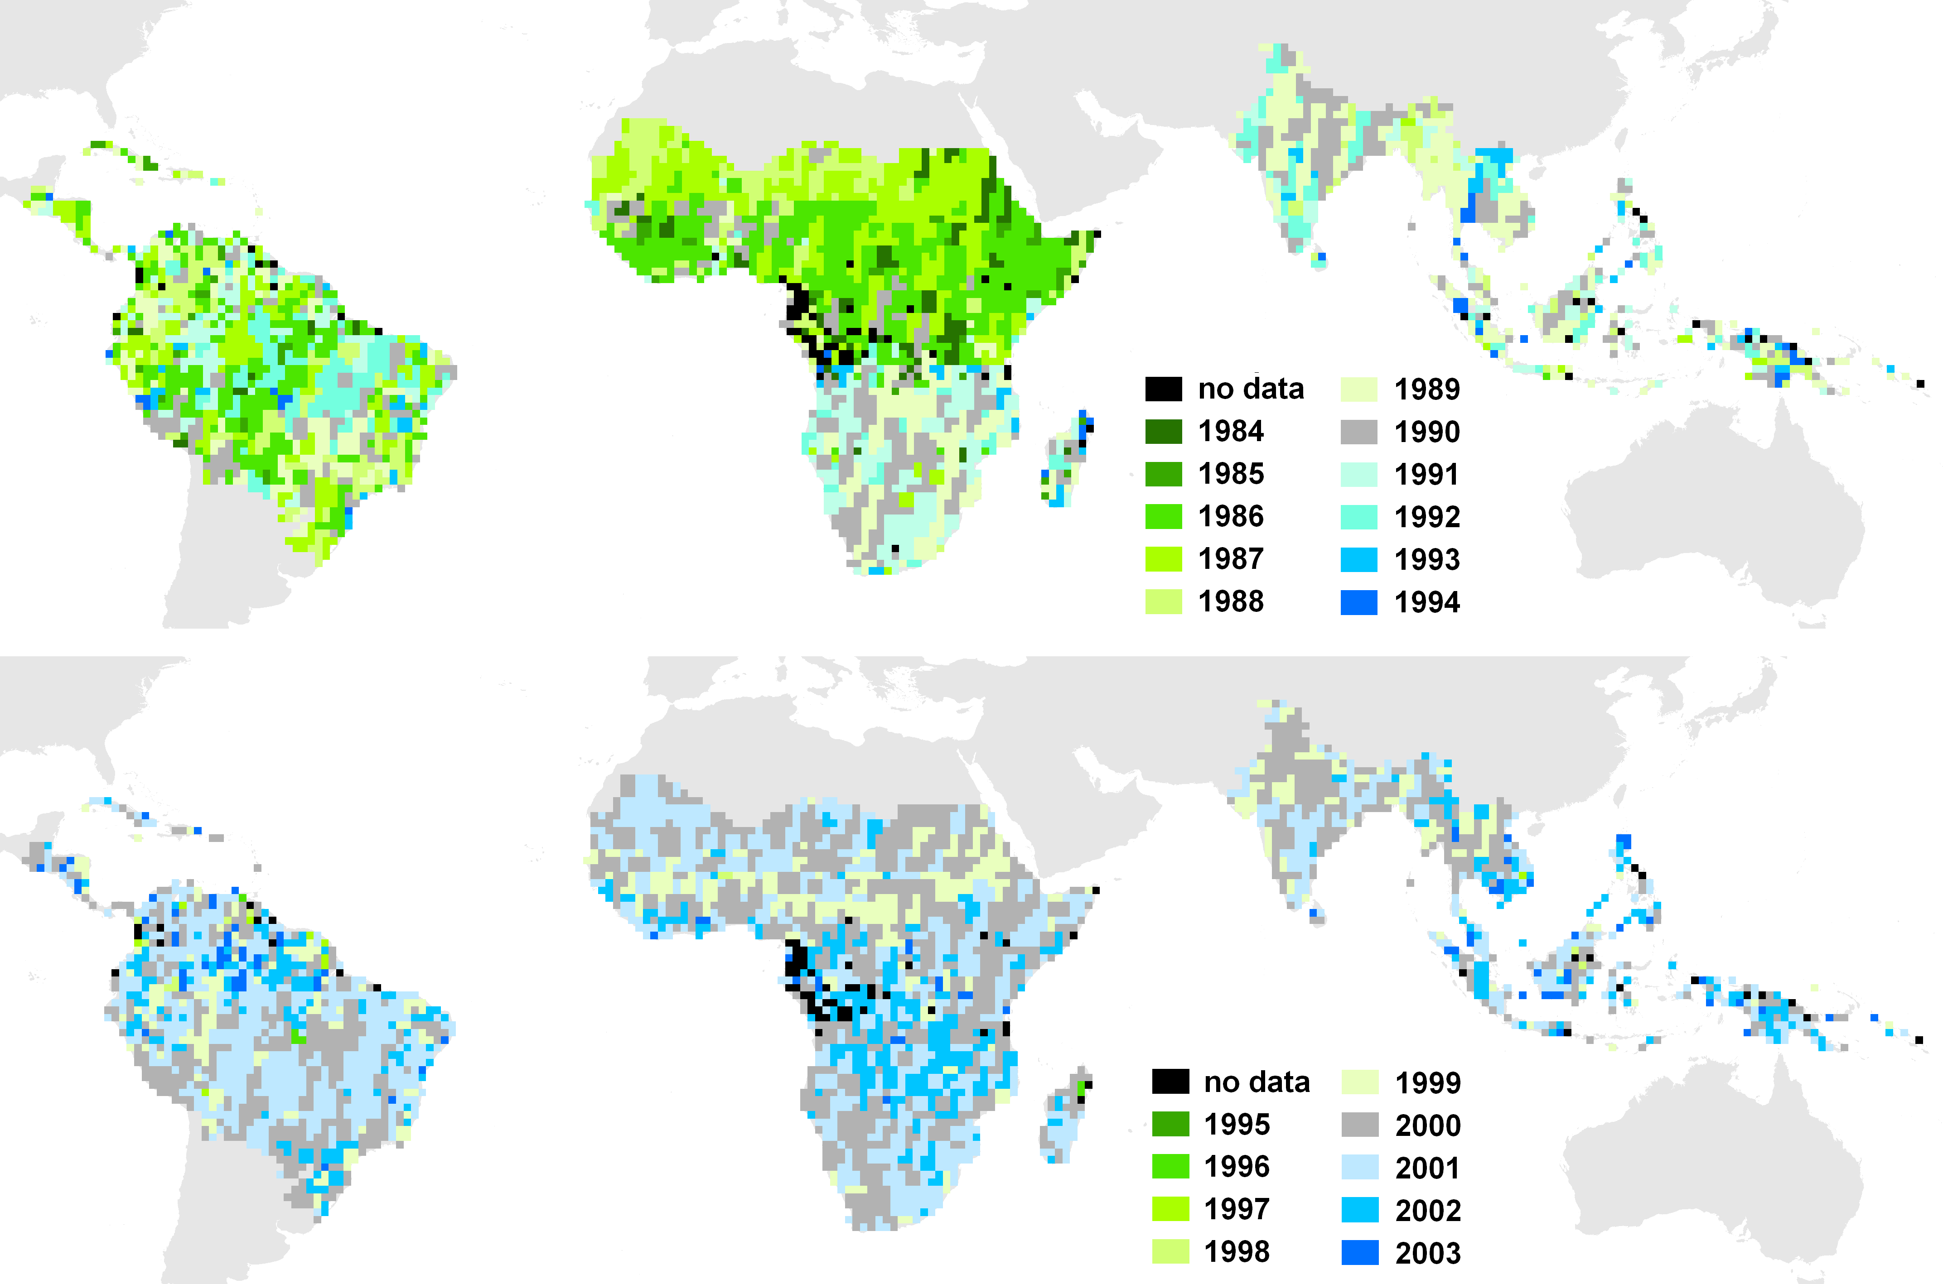
Major sources of limitations: Scarcity of historical data
Actual acquisition year for target year 1990
Actual acquisition year for target year 2000
Source: JRC; Beuchle et al. 2011
Notes:
This slide presents an example of the actual availability of Landsat cloud free observations over 20 x 20 km sampling sites located at the coordinate confluences for target years 1990 and 2000. Although the nominal observation frequency for the Landsat images is every 16 days, the actual availability of usable scenes is dramatically less, especially in humid tropical areas.
Note that the images acquired during the target years (1990 and 2000) are a clear minority of all images used for the epochs. This is the case especially for the 1990 epoch.
For the 2000 epoch the situation is somewhat better. Nevertheless, even in 2000, with a full year of observations, less than half of the sample locations could have been covered with usable data.

Slide 43
In summary
The IPCC guidance and UNFCCC decisions provide general guidelines that should be used to develop national forest definitions and monitoring approaches for REDD+ activities.
Numerous remote sensing data and methods can be used to monitor activity data for forests, preferably with:
  Multidate image analysis to detect changes
  Supervised, repeatable classification approaches
  Visual verification and rigorous accuracy assessment of the resulting maps
Even with the limitations of satellite observation, remote sensing is indispensable for monitoring activity data for forests in tropical countries.

Slide 44
Country examples and exercises
Country examples
Brazil (PRODES deforestation monitoring program)
India (FSI: The Forest Survey of India)
Democratic Republic of the Congo (JRC-FAO Systematic sampling)
Exercises
Using Landsat time series data to derive forest area change estimates

Slide 45
Recommended modules as follow up
Module 2.2 to proceed with monitoring activity data for forests remaining forests (incl. forest degradation)
Module 2.8 for overview and status of evolving technologies, including, for example, radar data
Modules 3.1 to 3.3 to learn more about REDD+ assessment and reporting

Slide 46
References
Beuchle, R., et al. 2011. “A Satellite Dataset for Tropical Forest Change Assessment.” International Journal of Remote Sensing 32: 7009–7031. doi:10.1080/01431161.2011.611186.
Bodart, C., et al. 2011. “Pre-processing of a Sample of Multi-scene and Multi-date Landsat Imagery used to Monitor Forest Cover Changes over the Tropics.” ISPRS Journal of Photogrammetry and Remote Sensing 66: 555–563.
Eva, H. D., et al. 2012. “Forest Cover Changes in Tropical South and Central America from 1990 to 2005 and Related Carbon Emissions and Removals.” Remote Sensing 4 (5): 1369–1391. doi:10.3390/rs4051369.
FAO (Food and Agriculture Organization). 2010. FAO Forest Resources Assessment of 2010 (FRA). Rome: FAO. http://www.fao.org/docrep/013/i1757e/i1757e.pdf.
FAO. 2015. FAO Forest Resources Assessment of 2015 (FRA). Rome: FAO. http://www.fao.org/forestry/fra/fra2015/en/.
GFOI (Global Forest Observations Initiative). 2014. Integrating Remote-sensing and Ground-based Observations for Estimation of Emissions and Removals of Greenhouse Gases in Forests: Methods and Guidance from the Global Forest Observations Initiative. (Often GFOI MGD.) Geneva, Switzerland: Group on Earth Observations, version 1.0. http://www.gfoi.org/methods-guidance/.

Slide 47
GOFC-GOLD (Global Observation of Forest Cover and Land Dynamics). 2014. A Sourcebook of Methods and Procedures for Monitoring and Reporting Anthropogenic Greenhouse Gas Emissions and Removals Associated with Deforestation, Gains and Losses of Carbon Stocks in Forests Remaining Forests, and Forestation. (Often GOFC-GOLD Sourcebook.) Netherland: GOFC-GOLD Land Cover Project Office, Wageningen University. http://www.gofcgold.wur.nl/redd/index.php.
Hansen, M. C., et al. 2013. “High-resolution Global Maps of 21st-century Forest Cover Change.” Science 342: 850–853.
Herold, M. 2009. An Assessment of National Forest Monitoring Capabilities in Tropical Non-annex I Countries: Recommendations for Capacity Building. Report for The Prince’s Rainforests Project and The Government of Norway. Friedrich-Schiller-Universität Jena and GOFC-GOLD. http://princes.3cdn.net/8453c17981d0ae3cc8_q0m6vsqxd.pdf
IPCC, 2003. 2003 Good Practice Guidance for Land Use, Land-Use Change and Forestry, Prepared by the National Greenhouse Gas Inventories Programme, Penman, J., Gytarsky, M., Hiraishi, T., Krug, T., Kruger, D., Pipatti, R., Buendia, L., Miwa, K., Ngara, T., Tanabe, K., Wagner, F. (eds.). Published: IGES, Japan. http://www.ipcc-nggip.iges.or.jp/public/gpglulucf/gpglulucf.html (Often referred to as IPCC GPG)
Raši, R., et al. 2011. “An Automated Approach for Segmenting and Classifying a Large Sample of Multi-date Landsat-type Imagery for pan-Tropical Forest Monitoring.” Remote Sensing of Environment 115: 3659–3669.

Slide 48
Simonetti, D., et al. 2011. User Manual for the JRC Land Cover/Use Change Validation Tool. EUR - Scientific and Technical Research Reports. Brussels: Publications Office of the European Union. http://publications.jrc.ec.europa.eu/repository/handle/111111111/16104.
Stibig, H.J., et al. 2003. “Mapping of the Tropical Forest Cover of Insular Southeast Asia from SPOT4-Vegetation Images.” International Journal of Remote Sensing 24 (18): 3651–3662.
USGS (US Geological Survey). 2015. Global Land Survey (GLS) Datasets. Last modified April 20, 2015. http://glovis.usgs.gov/.
Notes:
Thank you for listening to this lecture

